Slide 1
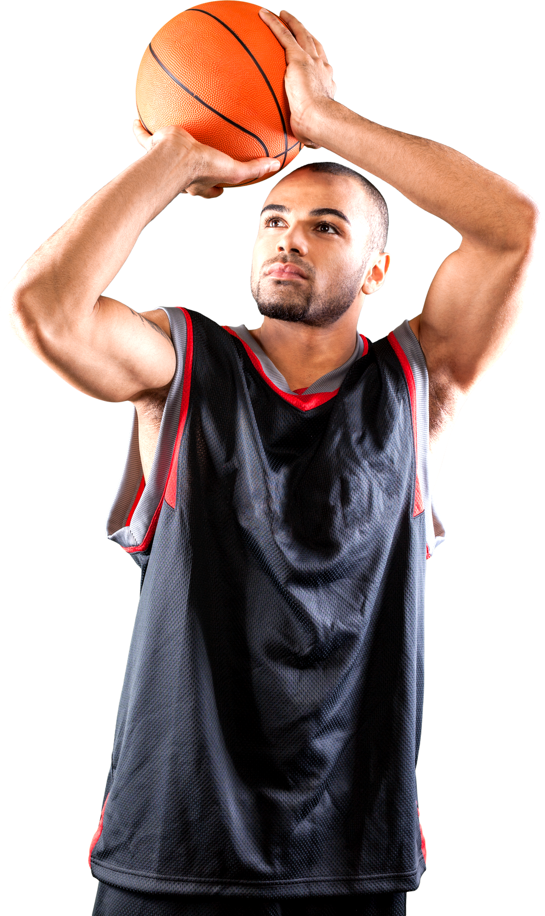


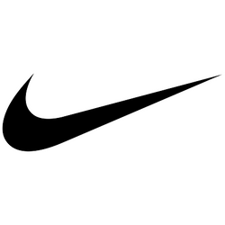





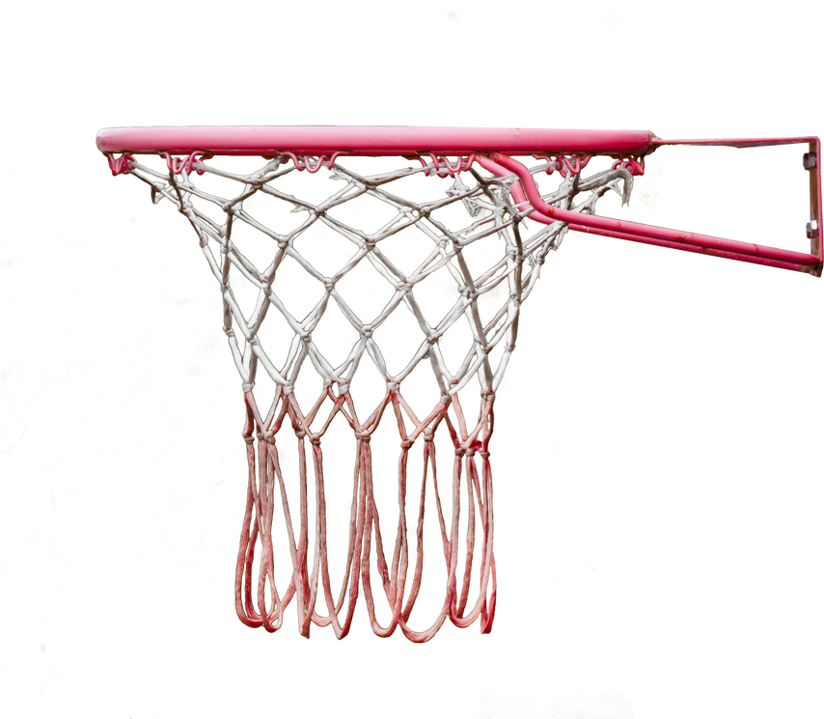


NIKE'S MARKETING PLAN
BASED ON NBA FAN ENGAGEMENT ON TWITTER
ALLSTAR & CHAMPIONSHIP
NBA
BY BELINDA DARKO
Notes:
Hello everyone!
My name is Belinda Darko and I will be presenting a marketing plan for Nike based on NBA fan engagement on Twitter in 2020.

Slide 2
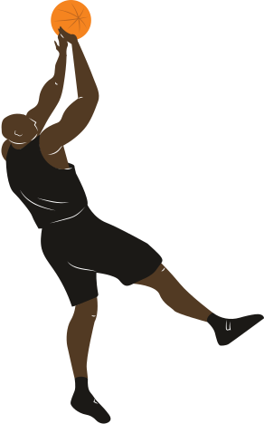
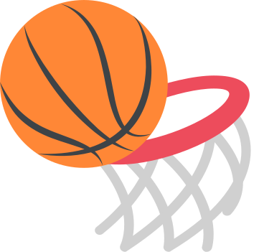
TABLE OF CONTENTS
01
THE CASE CHALLENGE
02
NIKE'S FINANCIAL PERFORMANCE
03
ALLSTAR & CHAMPIONSHIP
04
DATA PROCESSING
05
WORD ASSOCIATION
06
TOP TWEETS
07
RECOMMENDATIONS
Notes:
I will start off with the case challenge and the objective of this marketing plan.
Then I will look into Nike's financial performance during the pandemic and the market in sportswear overall.
Moreover, I will share the reasons why I chose to look at tweets done during Allstar & championship season, followed by the data processing, key insights on word associations from the tweets, top tweets, and last but not least my recommendations for the marketing team to allocate spending.

Slide 3
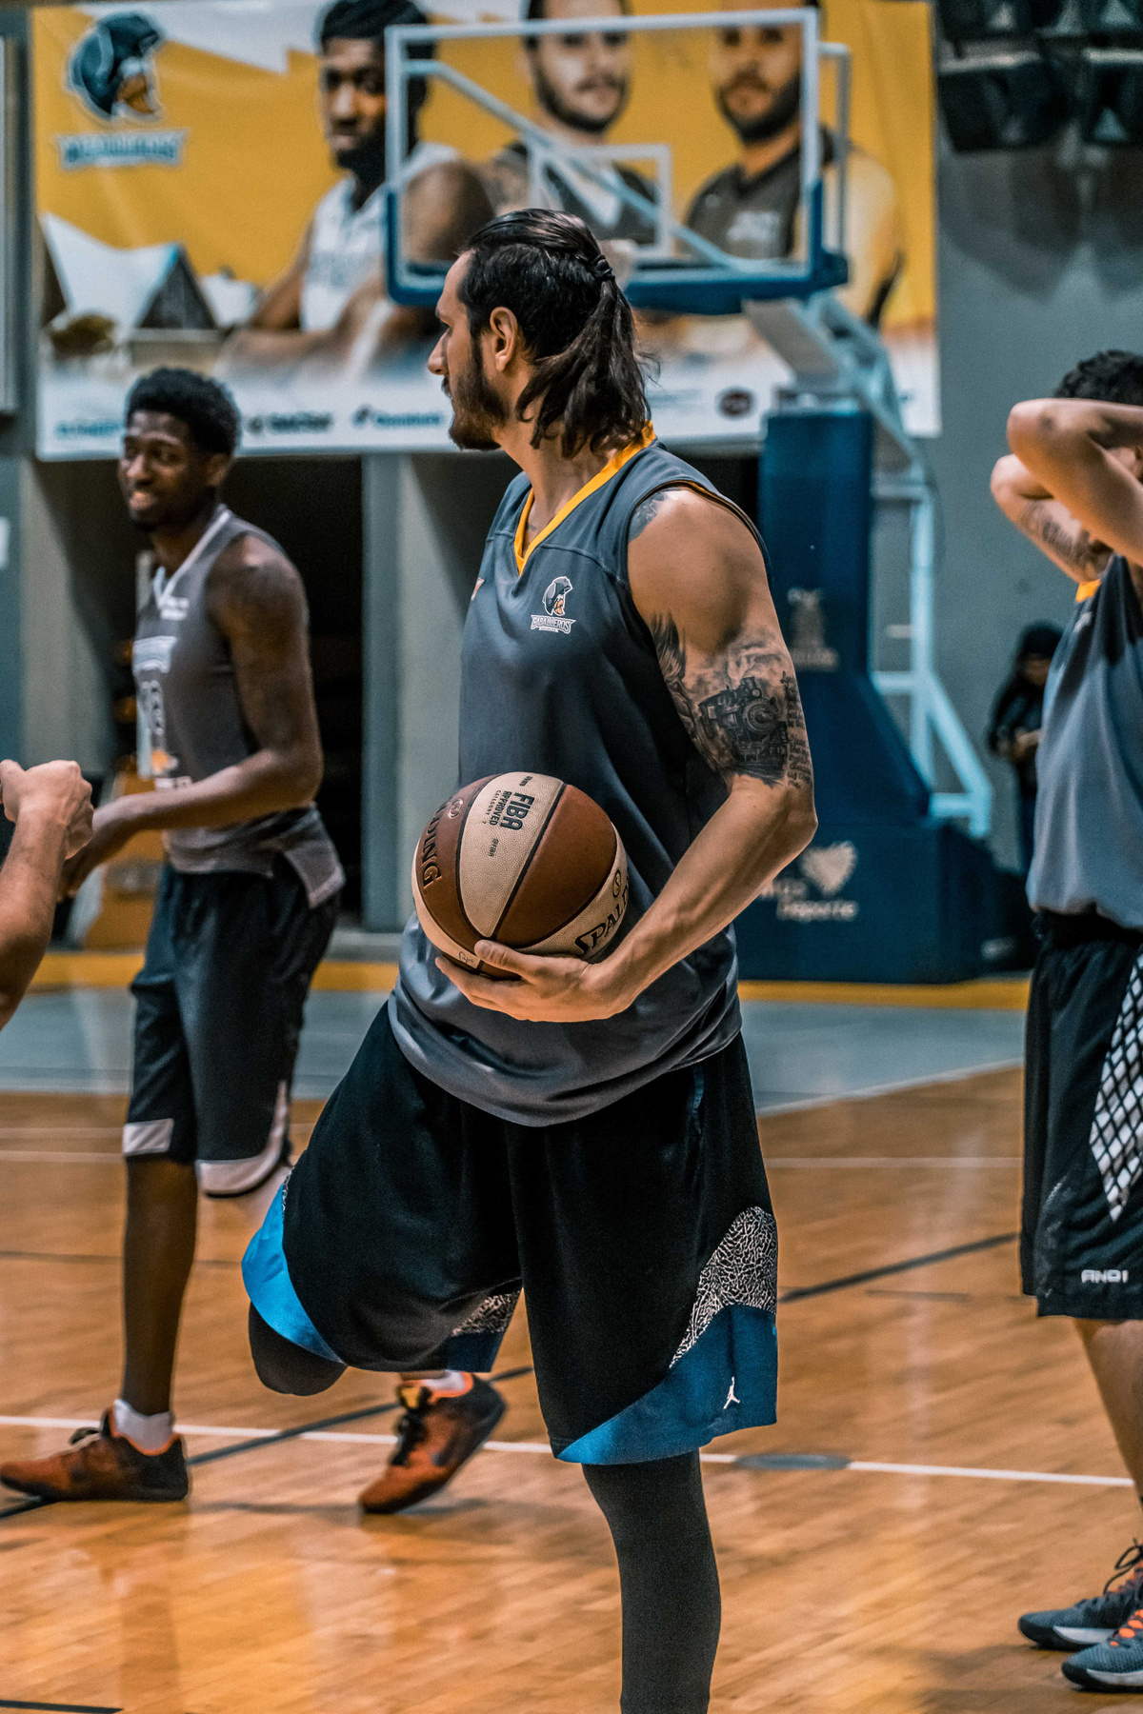
THE CASE CHALLENGE
Explored over 1.1 million tweets
Allstar game & championship
Commentary about top teams & players
Where should we allocate spend?
Notes:
I was handed a big data set from Oct 19 - Oct 20 where I decided to explore over 1.1 million tweets related to the Allstar game & championship season, specifically looking at the months Feb, Sept & Oct 2020.
The case challenge is to find commentary about top teams and players mentioned in the tweets and where the marketing team should allocate spending?

Slide 4
FINANCIAL PERFORMANCE
-42 %
-35 %
Apparel sales dropped
Footwear sales dropped
-7.06 %
75 %
Nike's annual gross profit reduced by 7.06 % from 2019
Digital sales soared during the pandemic
Notes:
First, let's look at Nike's financial performance. Apparel sales dropped by 42 %, while footwear sales dropped by 35 % due to the pandemic.
This led to a reduction of Nike's annual gross profit by 7.06 %.
However, we see the opposite effect on digital sales as it soared up to 75 %. This represents about 30% of total revenue, as shoppers flocked to Nike’s website for sneakers and workout gear. This is a huge opportunity for Nike to invest further in e-commerce in the future.

Slide 5
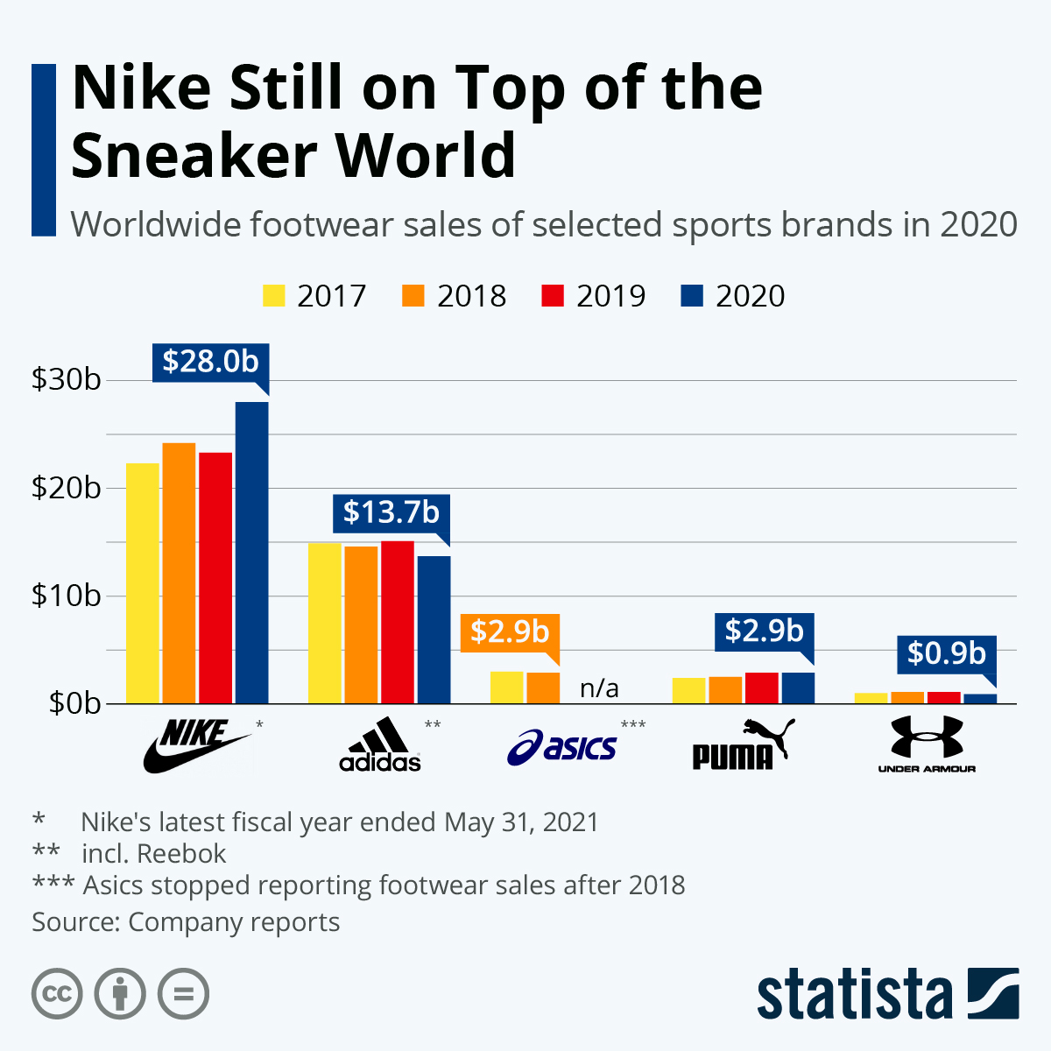

Notes:
Despite the losses that were made during the pandemic, Nike still has the biggest global market share in sportswear compared to Adidas, Asics, Puma, and Under Armour and have gained $28 b in footwear sales during 2020.

Slide 6
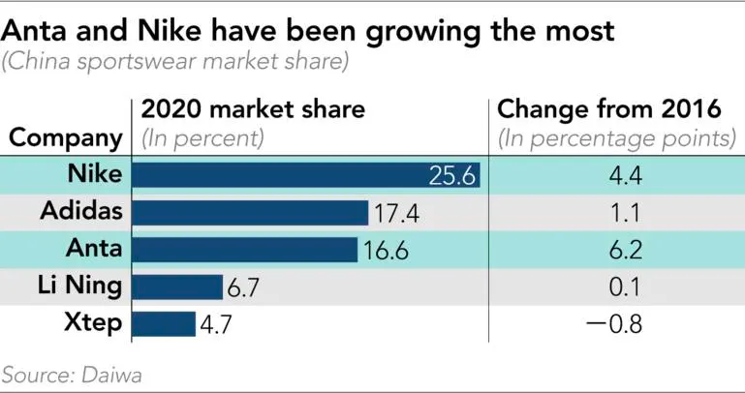
MARKET SHARE BY BRANDS IN CHINA
Notes:
Nike doesn't only have the highest market share in the US as they are based in Oregon, but also in China. Note that Nike and the Chinese sportswear company Anta are the two companies with the highest increase in market share in 2020, where Anta had a revenue of $5.4b during this year. It will be elaborated further about the opportunities in the Chinese market.

Slide 7


GLOBAL SPORTSWEAR MARKET SHARE BY PRODUCT TYPE
Wearables
1%
Footwear
34%
Apparel
65%
Notes:
Sportswear is usually fragmented into footwear, apparel, and wearables, where we see that the apparel segment is projected to dominate the market due to the high demand not only in basketball but football, tennis, and others. The high participation of women in sports & individuals wanting to take better care of their health are factors that drive the sportswear market forward.
Investing more in apparel is an important opportunity that Nike should look into as they currently sell double the amount of footwear compared to apparel.

Slide 8
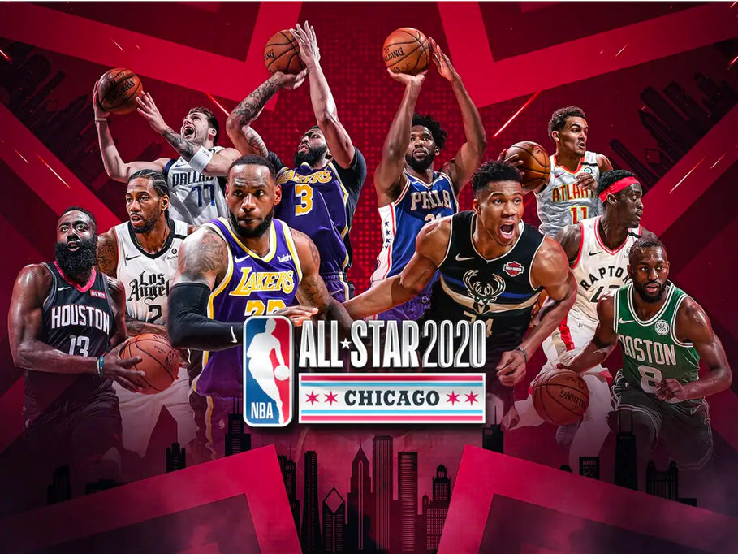
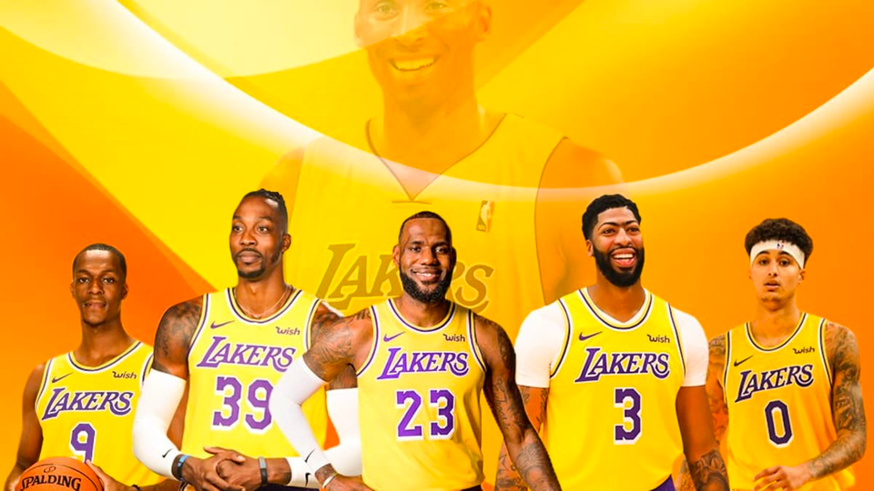
ALLSTAR GAME & CHAMPIONSHIP
Feb 2020 - Top athletes chosen by fans
Sept 2020 - Playoff season
Oct 2020 - Championship
Notes:
After looking at the financials, I wanted to look into these three specific months due to high fan engagement during all-star games, playoffs, and championship season in NBA.

Slide 9
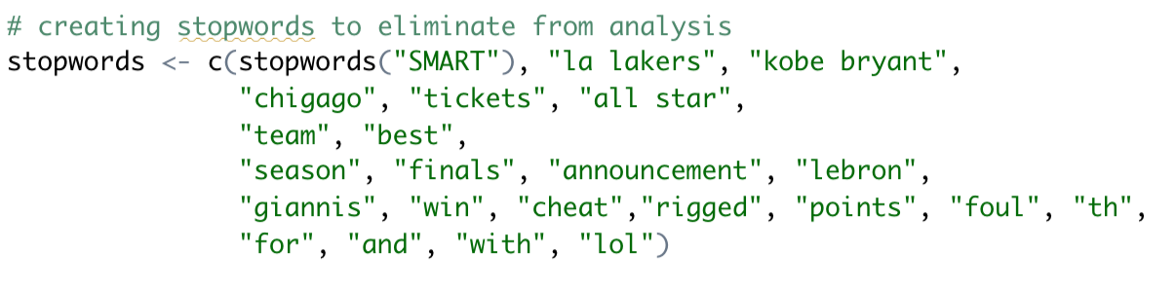
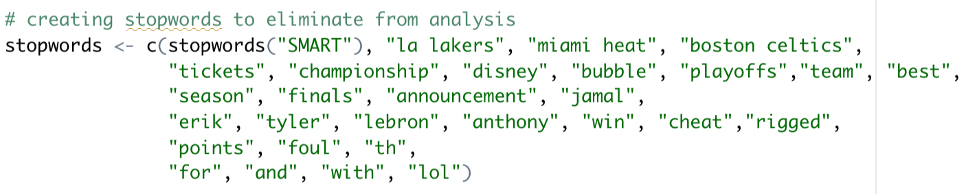
DATA PROCESSING
Allstar game:
Most tweeted teams:
Miami Heat
Boston Celtics
LA Lakers
Lebron mentioned 1.6 %
Giannis mentioned 1.2 %
Sampled 0.4 %
Sub-setted for top teams
Cleaned the data
Championship season:
Most tweeted teams:
Miami Heat
LA Lakers
Boston Celtics
Tate (rookie) mentioned 4 %
14,500 tweets
Sampled 0.4%
Sub-setted for top teams
Cleaned the data
Notes:
I started the data processing for the All-Star game and found that the most tweeted teams were Miami Heat, Boston Celtics & LA Lakers.
Moreover, I decided to see how frequently Lebron and Giannis were mentioned since they were the team captains of the All-Star competition, and we see that Lebron was mentioned more often than Giannis. I further cleaned the data by sampling 0.4 % of the dataset and sub-setted the data for the top three teams. Then I removed NBA-related words to find out what was most tweeted besides the regular words such as NBA, season, finals, tickets, Kobe Bryant, etc.
I did the same data processing for the championship season by merging Sept & Oct into one dataset to make the processing easier.
Due to the ongoing playoff seasons during September, I researched the top 10 rookies for this timeframe and saw that Jae'Sean Tate who plays for Houston Rockets was the only one who was mentioned as high as 4 % of the tweets, amounting to approx. 14,500 tweets in September. He happens to not have a current deal with Nike, which is a great opportunity for Nike to gain a competitive advantage.

Slide 10
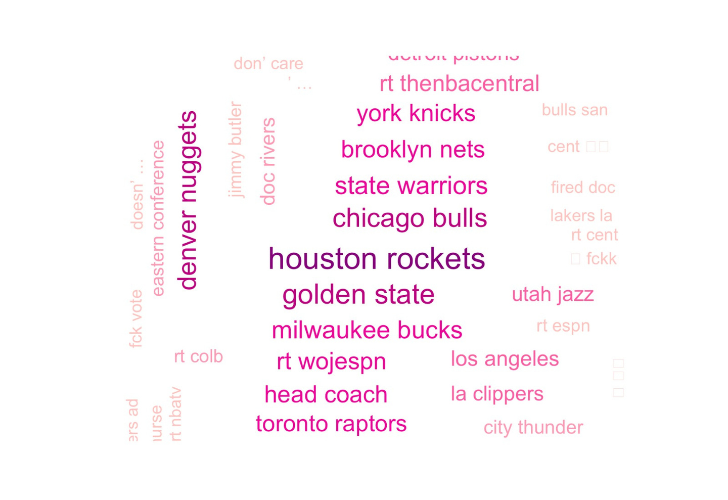
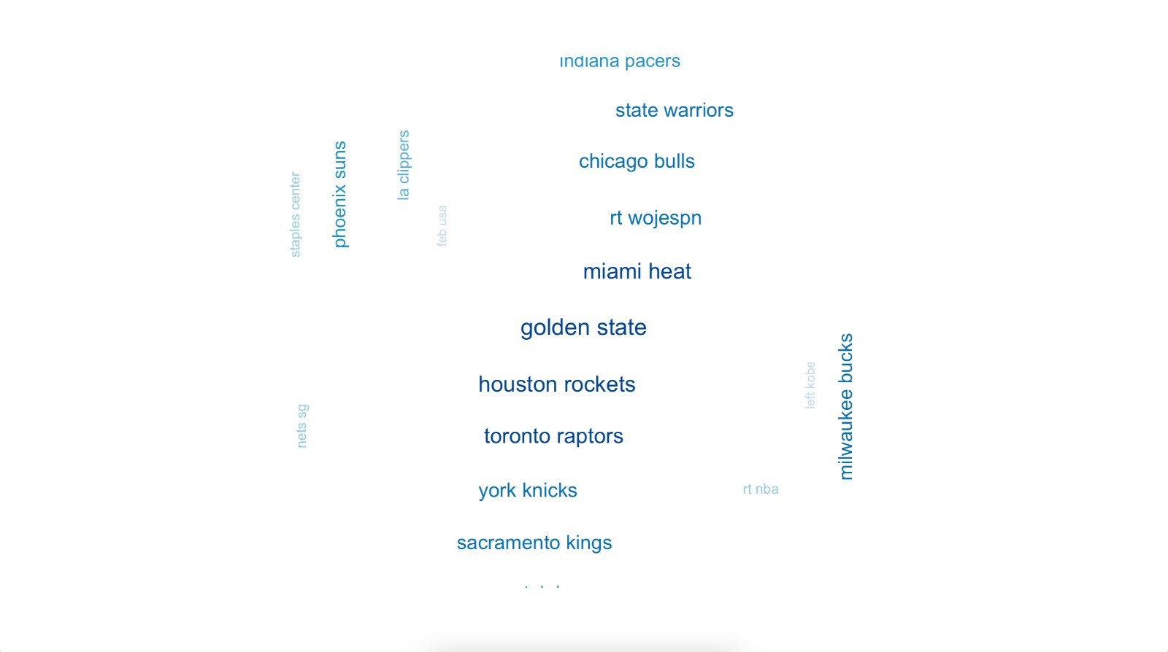
WORD ASSOCIATION
Allstar game
"nike"
Championship
"champ"
Notes:
Here are some key insights that I found during my data cleaning process. To the left, we see words associated with nike during the Allstar game season, while to the right we see words associated with champ during the championship season.
Houston rockets are mentioned a lot in both All-Star & championship season, which emphasizes the focus on signing Tate as previously mentioned and looking into other players playing for this team.
Other words that are associated with Nike and champ that are highly tweeted are Chicago bulls, Golden state, Denver nuggets, Miami heat, Toronto raptors, state warriors, and more.
Curiosity led me to also look into the top rookie for the Toronto Raptors as they are highly mentioned like Houston rockets. The top rookie is Precious Achiuwa, who has signed a deal with Anta Sports in China. This is an opportunity for Nike to invest more into Asia & the Pacific by considering a partnership.

Slide 11
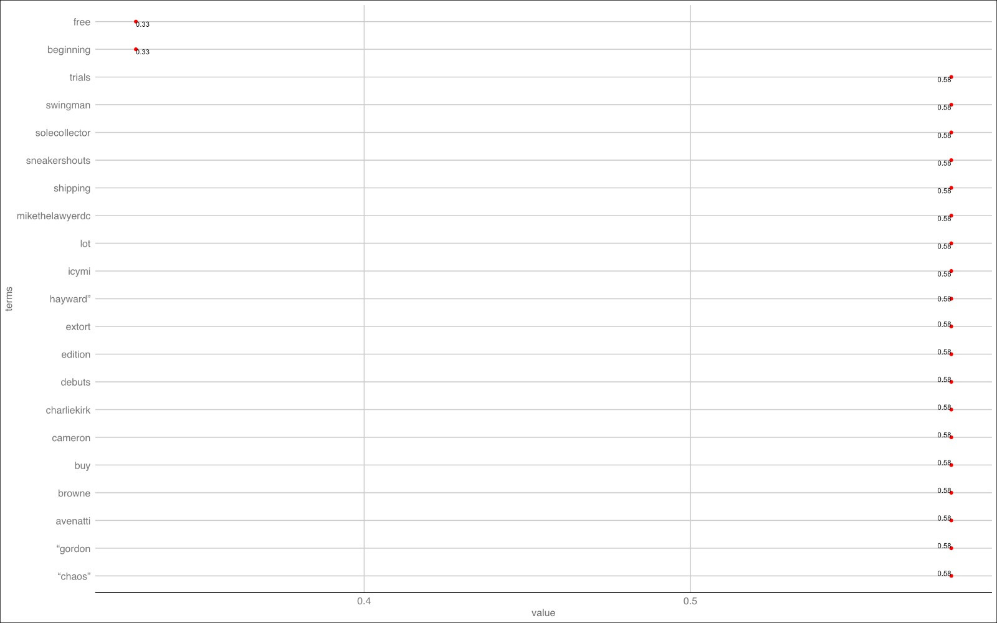
TOP TWEETS - ALLSTAR
Notes:
Here are additional top tweets and words that are mentioned in at least 30 % of the data.
Examples include sneaker shouts, shipping, Cameron, Hayward and Gordon.
Aaron Gordon was mentioned in 58 % of the tweets and plays for the Denver Nuggets. He already has a shoe deal with the company 361 degrees in China. He previously had a deal with Nike but left so he could have more autonomy.
Gordon Hayward is also another example of someone who signed a deal with Anta to have his own signature deal.
Other top players such as Klay Thompson & Rajon Rondo went overseas to get their signature shoe lines.
It is therefore highly recommended that Nike partner with Asian local brands and have some of these players feature some apparel as well as open up for athletes to create their own signature apparel.

Slide 12

RECOMMENDATIONS
1.
2.
Partner with top Asian local brands like Anta & 361 degrees
Create more apparel products
Sign more shoe endorsement deals with Houston Rockets players, such as Tate
Create more room for players to make their own signature shoes
3.
4.
Notes:
In conclusion, based on all the key insights derived from both the data & secondary research, these are my top 4 recommendations.

Slide 13
REFERENCES
https://www.statista.com/chart/13470/athletic-footwear-sales/
https://www.fortunebusinessinsights.com/sportswear-market-102571
https://www.macrotrends.net/stocks/charts/NKE/nike/gross-profit
https://www.nbcsports.com/boston/celtics/nba-power-rankings-who-are-10-best-rookies-2020-21-class
https://therookiewire.usatoday.com/2021/04/08/heat-precious-achiuwa-shoe-endorsement-deal-anta/
https://www.statista.com/statistics/241706/nikes-us-sales-by-product-category-since-2007/
https://asia.nikkei.com/Business/Consumer/Chinese-sportswear-brands-count-profits-from-Xinjiang-controversy
https://www.chinadaily.com.cn/a/202103/25/WS605c781aa31024ad0bab1a1e.html

